Slide 1

Pantry Queuing Simulation
Cornell University
School of Operations Research and information Engineering
July 2024

Slide 2
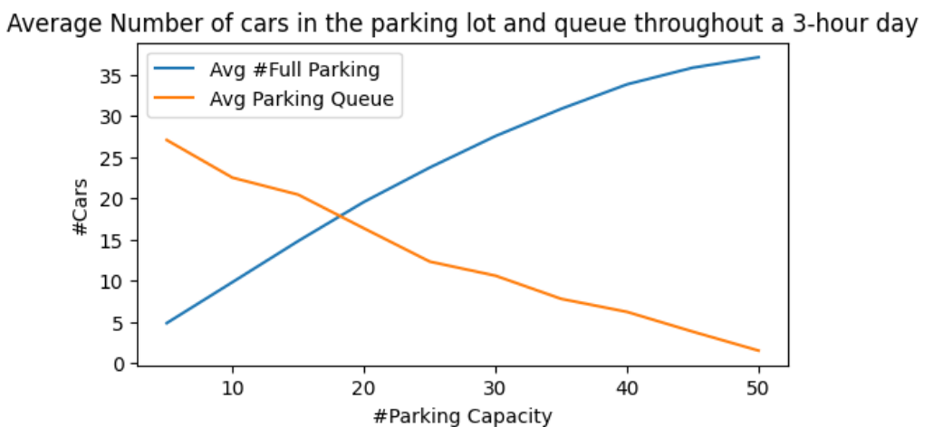
Varying Parking Capacity
Shorter Queue, and
more occupied spots!

Slide 3
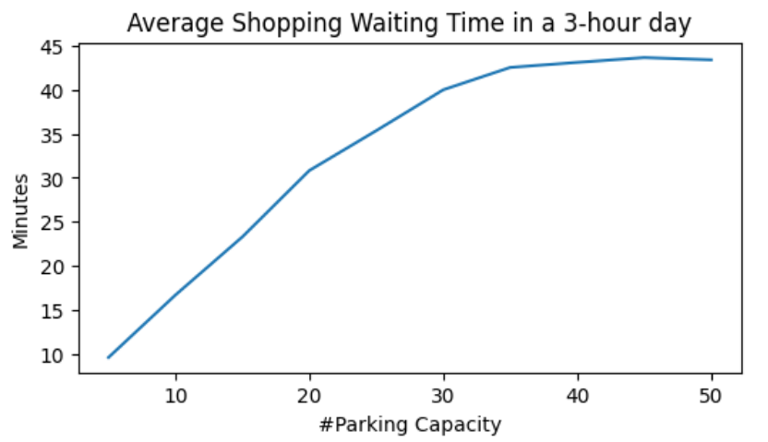
Varying Parking Capacity
More people in pantry, so longer waiting!

Slide 4
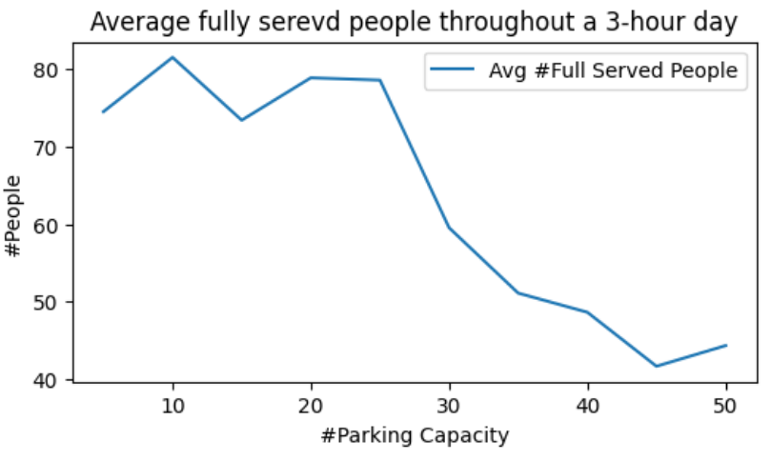
Varying Parking Capacity
Longer queues so
fewer people served!

Slide 5
Appendix

Slide 6









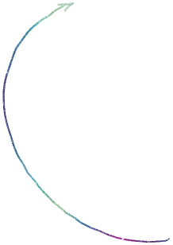




Slide 7
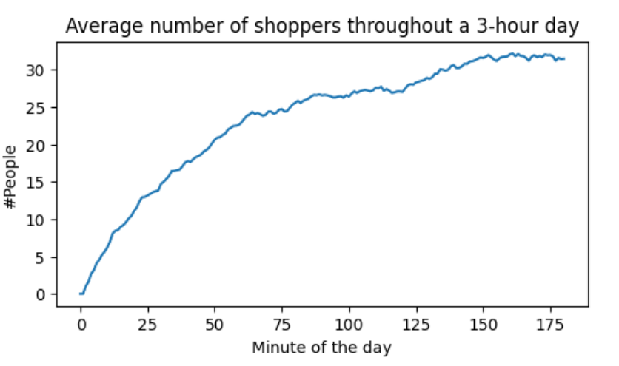
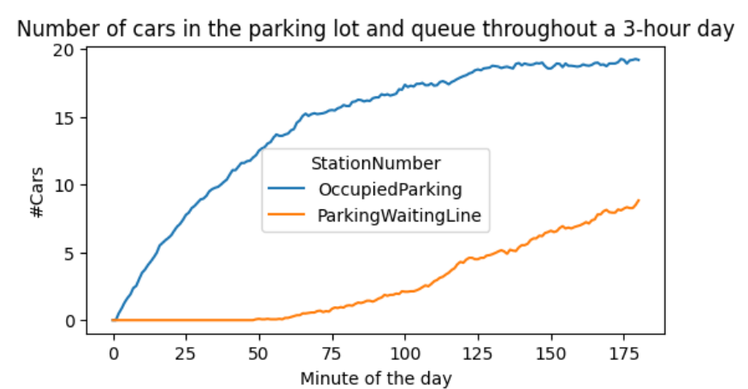
Average number of shoppers

Slide 8
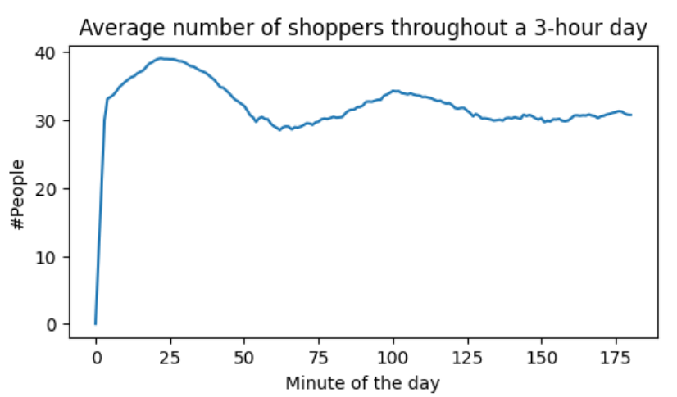
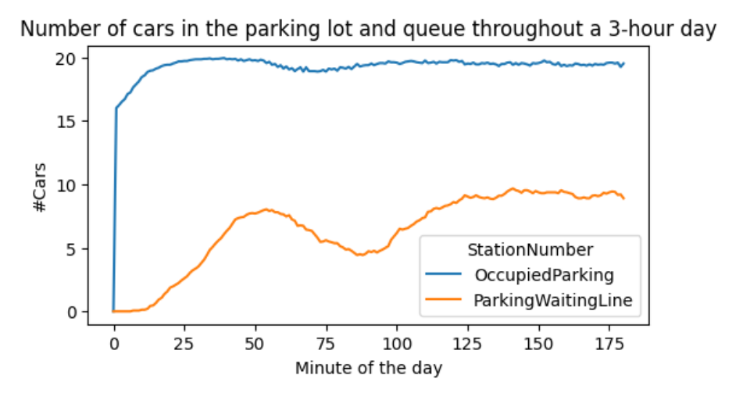
Right-tailed Arrival Rate

Slide 9
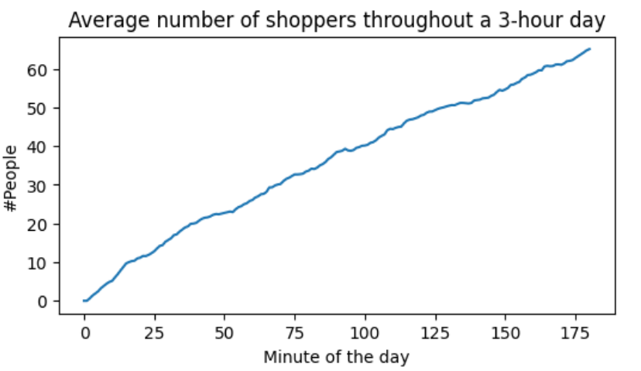
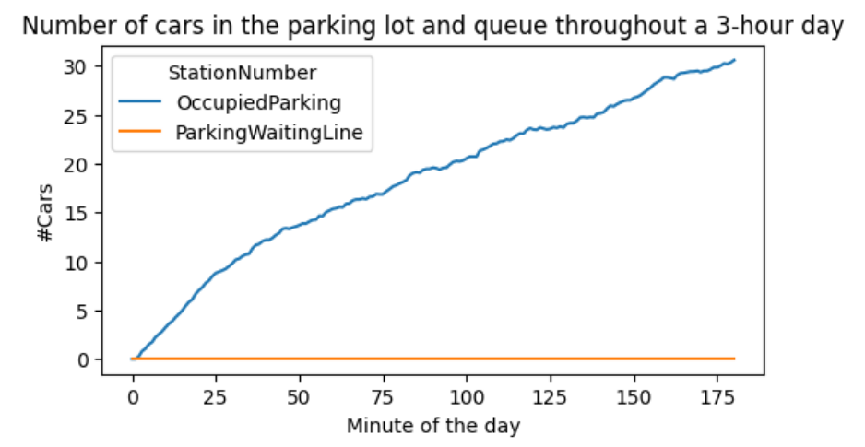
Infinite Parking Capacity

Slide 10
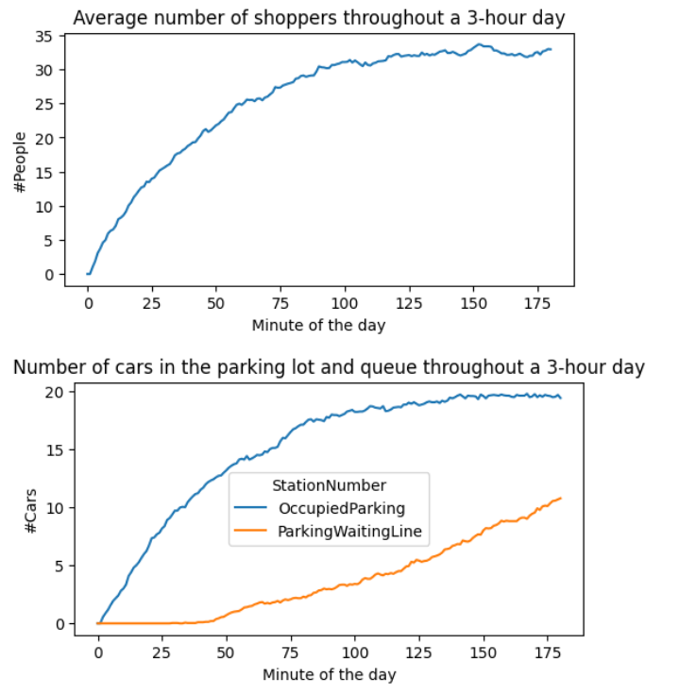
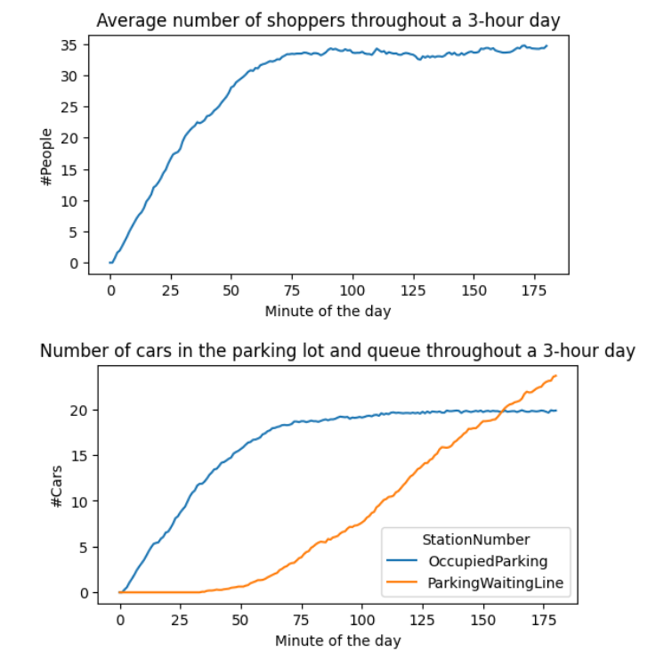
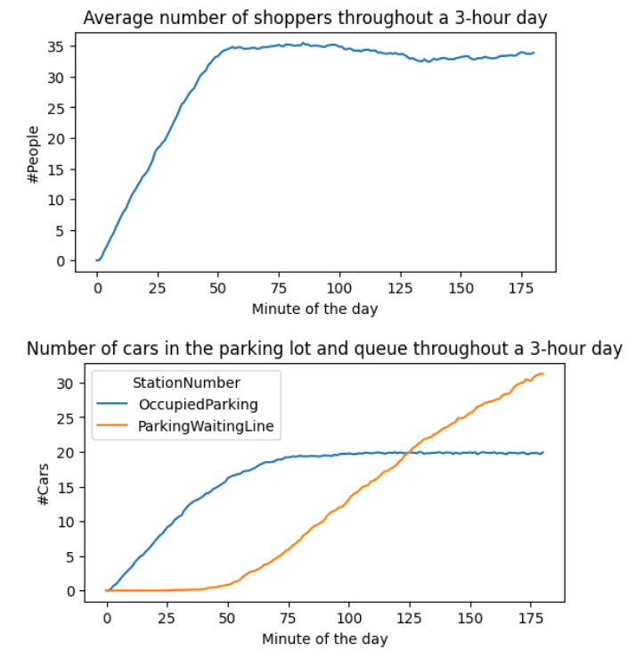
Shopping Times

Slide 11
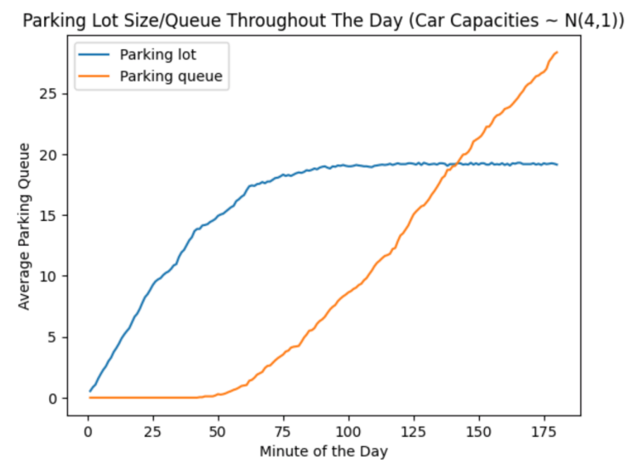
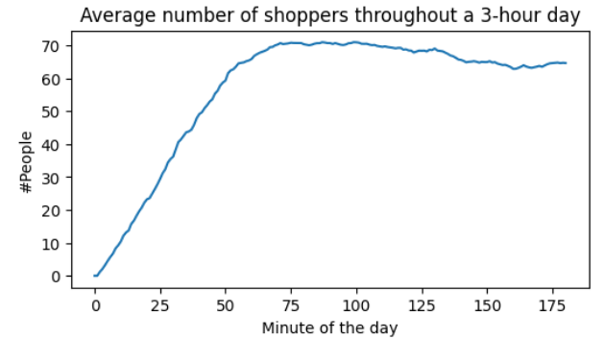
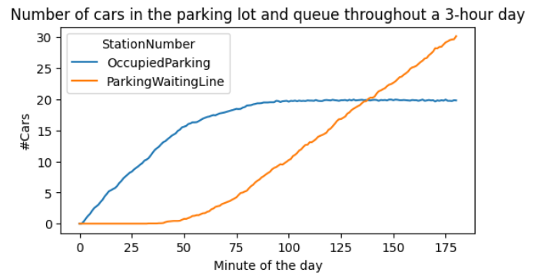
Varying Car Capacity

Slide 12

QA?

Slide 13
Thanks!

